Slide 1
GMS Database Consulting, Inc.
Muyeedul Hoque
Georgi Kardzhaliyski
Shahbaz Soofi
MIS 3720
October 5th, 2012

Slide 2
Problem Description
Industry: Customer Service
Company: WPI Technology Helpdesk
Problems:
No centralized database for tickets
No organized way of tracking which employees worked on what tickets
No meaningful data on queues, tickets per month, times at which tickets were logged, etc.

Slide 3
Our Solution
Created a database that includes:
Which employee(s) worked on a ticket
Queue times
Ticket description
Time a ticket is logged into the database
If ticket was received by e-mail, phone, or walk-in
Key Features:
Database Maintenance (ability to view and modify)
Reporting (view meaningful metrics)
Online Dashboard to monitor trends (by month, issue, etc.)

Slide 4
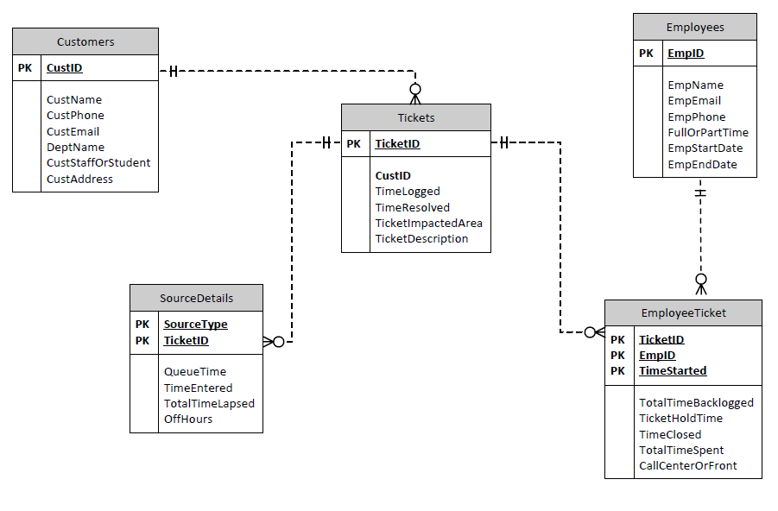
Entity-Relationship Diagram

Slide 5
Database User Interface
View employees, modify employees
Add a Customer
Use online dashboard features
Export Reports
Analyze reports

